Slide 1
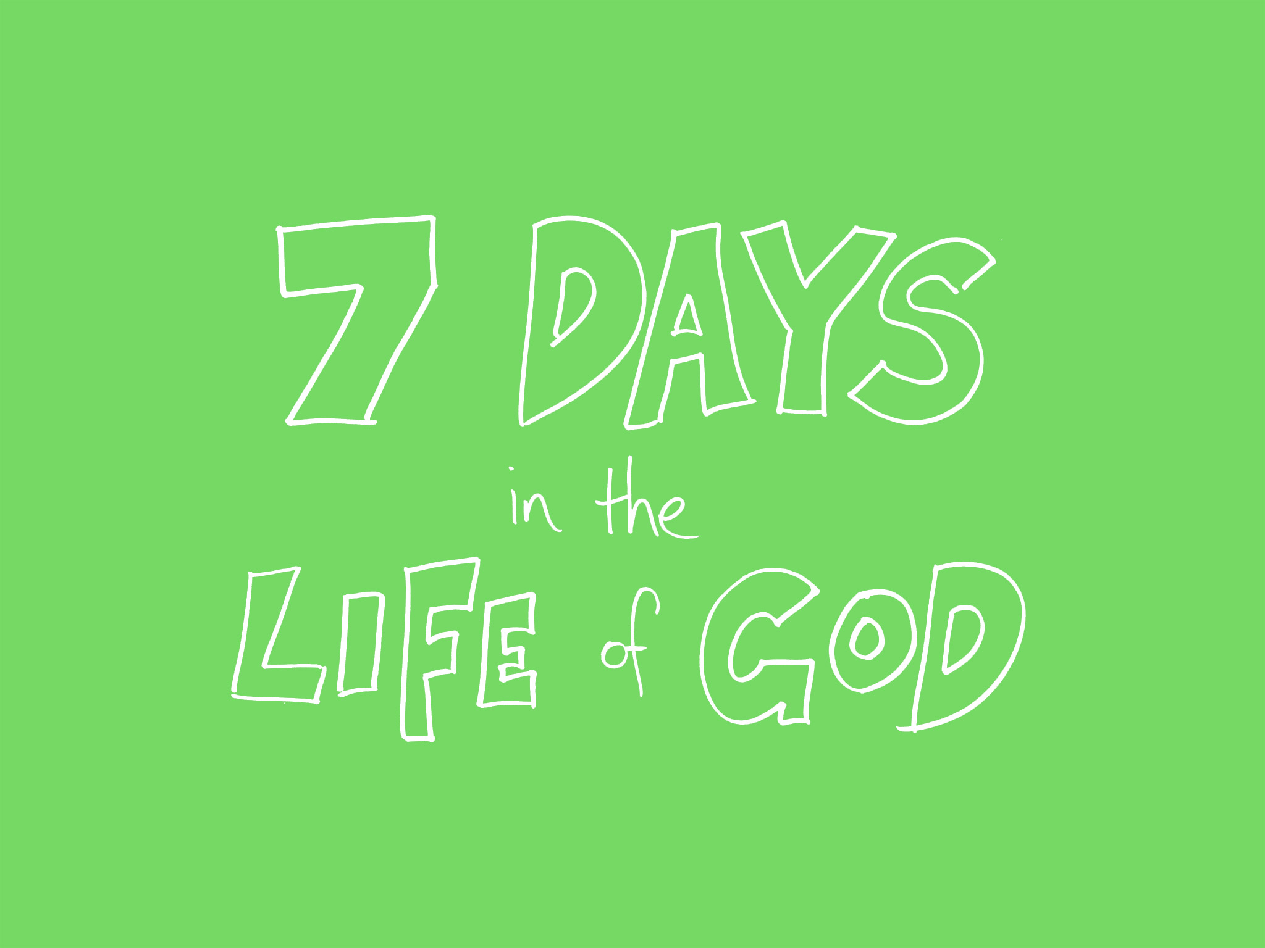
© 2012 Snack Music Productions

Slide 2
God saw all that
He had made
And it was
very good

Slide 3

On the 1st day
God created the heavens and earth
He gave them worth

Slide 4

The 1st day
He separated the dark from light
Day from night

Slide 5

On the 2nd day
God created a space called sky
Where birds can fly

Slide 6

The 2nd day
He separated the water from the sky
The sky up high

Slide 7
God saw all that
He had made
And it was
very good

Slide 8

On the 3rd day
God created the land
and the sea
The plants and trees

Slide 9

The 3rd day
God created fruit
bearing trees
That drop their seeds

Slide 10

On the 4th day
God created
the sun so bright,
the moon for night

Slide 11

The 4th day
God created
stars to light
The sky at night

Slide 12
God saw all that
He had made
And it was
very good

Slide 13

On the 5th day
God created fish that swim,
Salmon and bream

Slide 14

The 5th day
God created birds flying high,
And walking by

Slide 15

On the 6th day
God created
Cows and dogs,
Spiders and frogs

Slide 16
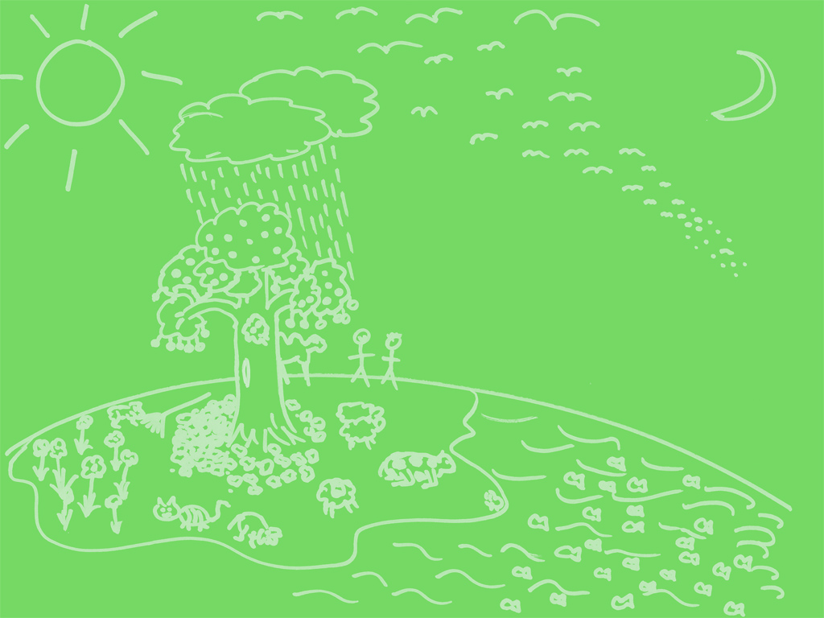
The 6th day
God created
Humans to rule the Earth so full

Slide 17
God saw all that
He had made
And it was
very good

Slide 18

On the 7th day
God rested

Slide 19
Snack Music

