Slide 1
© 2012 Snack Music Productions

Slide 2
God told Jonah to go to Nineveh
He didn't want to go, it was so far
He really wasn't all that keen,
The people were so mean

Slide 3
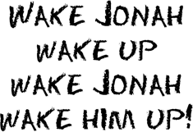
Jonah ran away and got on a boat
A storm came up while it was still afloat
Jonah slept while the lightning flashed
And the waves all around him crashed

Slide 4
Ask your God, Jonah, make it go away
He said
Throw me out and all will be OK
They granted him his wish
He was swallowed up by God's big fish!

Slide 6
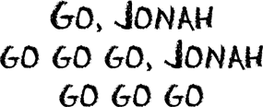
He didn't have a whale of a time in that fish
Gone for three days and three nights he was missed
He decided to obey God’s plan
So the fish spat him up on the dry land

Slide 9
Snack Music

