Slide 1
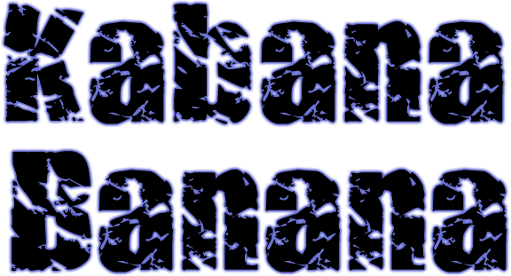
© 2006 Snack Music Productions

Slide 2
Doo-wop-a-
ditty-witty-
ning-nang-nong
Kabana, banana,
sing that song!

Slide 3
Snack Music

