Slide 1
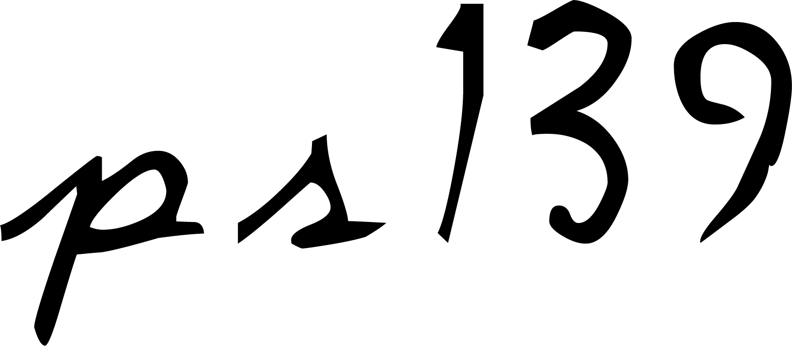
2007 Snack Music Productions

Slide 3
You made all the delicate, inner parts of my body
and knit me together in my mother’s womb.
Thank you for making me so wonderfully complex!
Your workmanship is marvellous – how well I know it.
You watched me as I was being formed in utter seclusion, as I was woven together in the dark of the womb.

Slide 4
You saw me before I was born.
Every day of my life was recorded in your book.
Every moment was laid out,
before a single day had passed.

Slide 5
How precious are your thoughts about me, O God.
They cannot be numbered!
I can’t even count them;
they outnumber the grains of sand!
And when I wake up, you are still with me…

Slide 6
And when I wake up, you are still with me…

Slide 8
Bible text from New Living Translation
© 1996, 2004 by Tyndale Charitable Trust
Snack Music

