Slide 1
© 2012 Snack Music Productions

Slide 2
The sparrow and his friends
with their feathered wings
Fly above the clouds
They flap and chirp and sing

Slide 3
Have no care ‘bout what they wear
God gives them all they need

Slide 4
The sun begins to set
They find a tree to rest
They make themselves a home
And build a little nest

Slide 5
Have no care ‘bout where they live
God gives them all they need

Slide 6
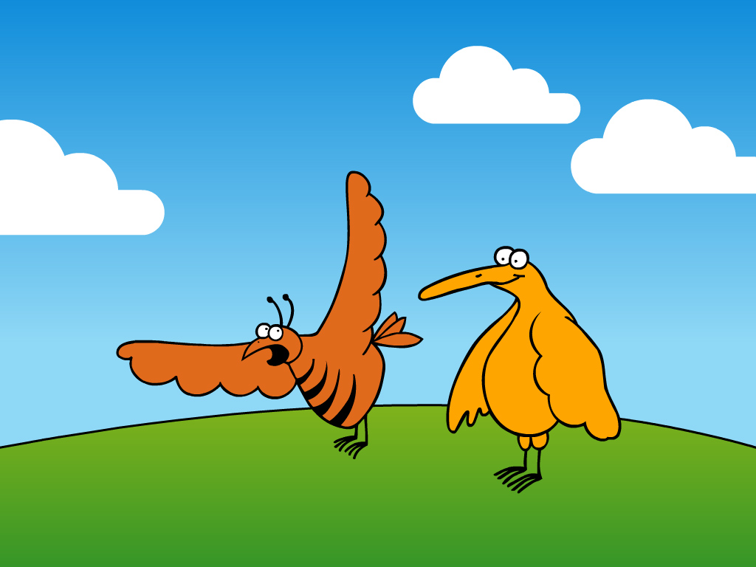
God loves the sparrows
And takes great care of them
He loves us even more
So don’t worry for anything
God gives us all we need

Slide 7
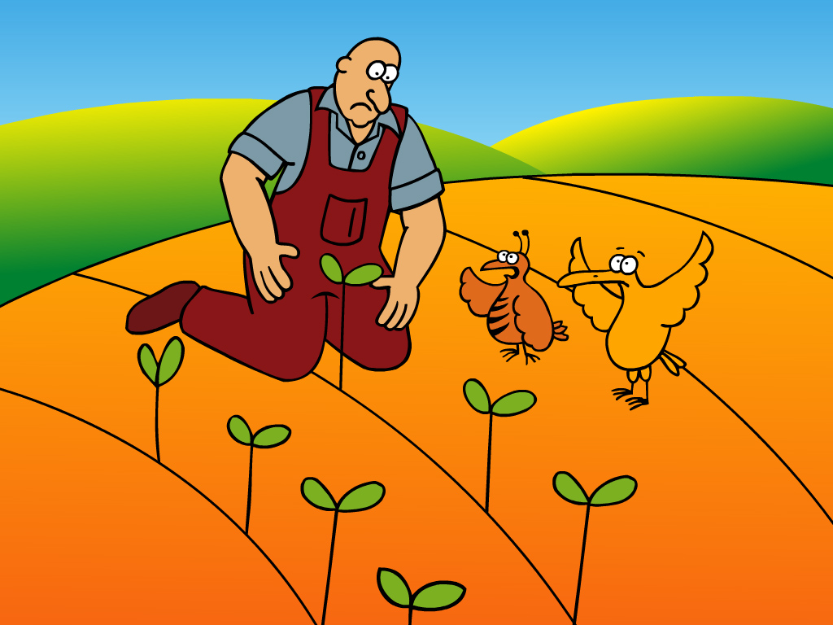
The lilies of the field
With their sweet perfume
Standing in the breeze
Their colours in full bloom

Slide 8
Have no care ‘bout what they wear
God gives them all they need

Slide 9
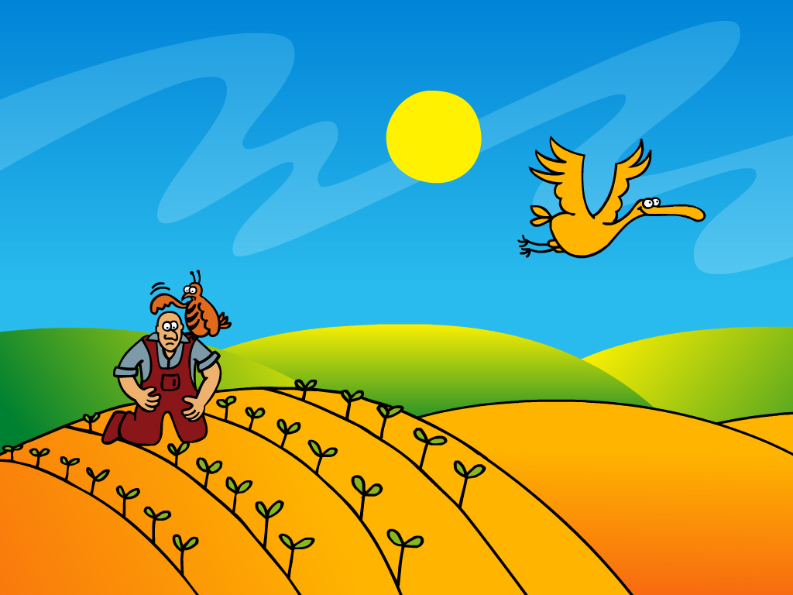
The moon comes out to shine
Their petals close to sleep
Until a new day comes
When the morning sun they’ll greet

Slide 10
Have no care ‘bout where they live
God gives them all they need

Slide 11
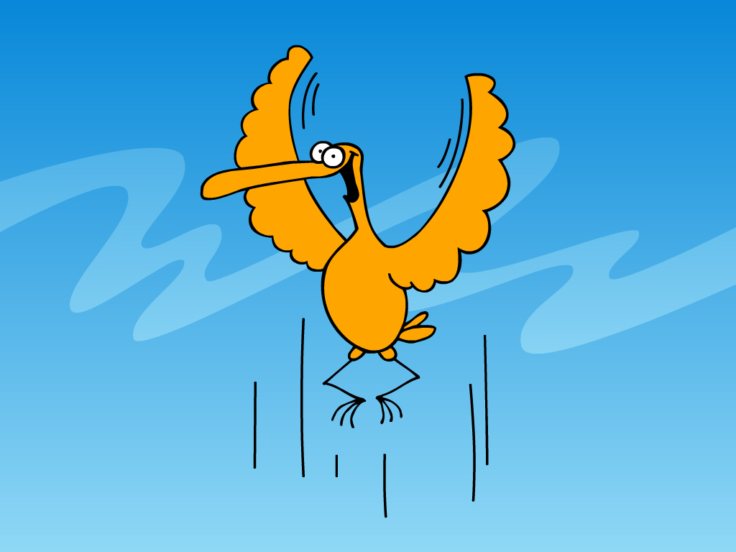
God loves the lilies
And takes great care of them
He loves us even more
So don’t worry for anything
God gives us all we need

Slide 12
God loves the lilies
And takes great care of them
He loves us even more
So don’t worry for anything
God gives us all we need
God loves the lilies
And takes great care of them
He loves us even more
So don’t worry for anything
God gives us all we need…

Slide 13
Images by
Snack Music

