Slide 1
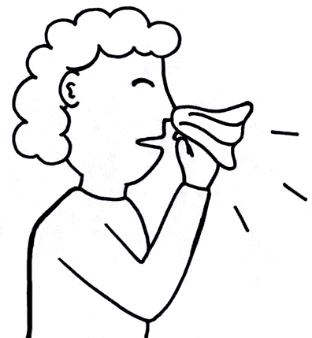
© 2006 Snack Music Productions

Slide 2
No matter how we sneeze,
No matter how we sneeze,
No matter how we sneeze,
God loves us the same!

Slide 3
Some people sneeze small,
some people sneeze big,
some people's sneezes snort like a pig.
Some people sneeze loud,
some people sneeze soft,
some people sneeze upstairs in the loft!

Slide 4
No matter how we sneeze,
No matter how we sneeze,
No matter how we sneeze,
God loves us the same!

Slide 5
Some people sneeze once,
some people sneeze twice,
some people sneeze ten times,
it's not nice!
Some people sneeze short,
some people sneeze long,
but everyone sneezes in this song!

Slide 6
No matter how we sneeze,
No matter how we sneeze,
No matter how we sneeze,
God loves us the same!

Slide 7
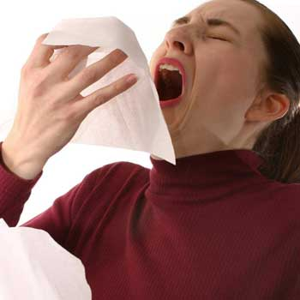
No matter how we sneeze,
No matter how we sneeze,
No matter how we sneeze,
God loves us the same!

Slide 9
No matter how we sneeze,
No matter how we sneeze,
No matter how we sneeze,
God loves us the same!

Slide 10
No matter how we sneeze,
No matter how we sneeze,
No matter how we sneeze,
God loves us the same!

Slide 11
Snack Music

